Slide 1
Introduction
OnlineBookstore
Supervisor:
Lê Thanh Nhân
Members:
Nguyễn Ngọc Bảo Duy_Student1387810
Bùi Nguyễn Hải Trí_Student1387799
Trịnh Hoàng Phước Sang_Student1387804
Lê Mai Minh Thiện_Student1387909
Date: 27/04/2023

Slide 2
Content
Introduction
Actual requirements
Requirements of the project
Deployment diagram
Test result
Conclusion and development
Task list

Slide 3
Introduction - Actual requirements
Our OnlineBookstore is an online shop that provides customers with a variety of books from many categories such as novel, fantasy, detective, etc…
With the desire to develop, the company understands that the demand for products not only comes from the local market but also the international market. A whole new website with fully functional will let our customers to access the products remotely, allowing us to reach out and expand our customer base. Not only does a website eliminate the need for opening multiple shops in different locations, but it can also save money on leaflets and physical advertisements like billboards and posters.

Slide 4
Introduction - Requirements of the project
Functional
For user :
Can register a member account and manage personal account
Can view and buy products
Can search products by name, author, category, country, year
Can sort by price, name and date
Can review a purchased product and reply to others’ reviews
Can view their orders and order history
Can send feedbacks to admin
Notes:
Non-functional (how the system works)
Functional (what the system should do)

Slide 5
Introduction - Requirements of the project
Functional
For admin:
Can add/ edit the accounts’ roles
Can add/view/edit/deactivate products and categories
Can view all orders and change status orders
Can add coupons for discount
Can manage users’ reviews
Can see users’ feedback on the website
Notes:
Non-functional (how the system works)
Functional (what the system should do)

Slide 6
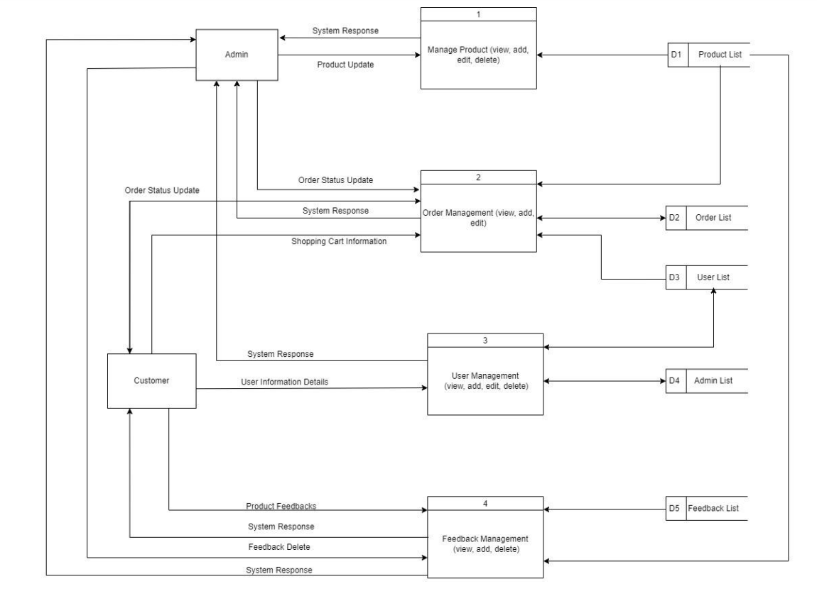
Introduction - Deployment diagram
Data Flow Diagram

Slide 7
Test Result
Functional | Table use | Actor | Status
Login Register Edit account information | Users | Guest | Done
View products Search product by name, author… Filter product Review product Add product to cart Order product View Order history | Product, Customer, Order | Guest | Done

Slide 8
Test Result
Functional | Table use | Actor | Status
Login | Admin | Admin | Done
Order Management | Order | Admin | Done
Accounts’ roles Management | Admin | Admin | Done
Product/Category Management | Product, Category | Admin | Done
Coupon Management | Coupons | Admin | Done
Feedback Management | Feedbacks, Reply | Admin | Done
Contact Management | Contacts | Admin | Done

Slide 9
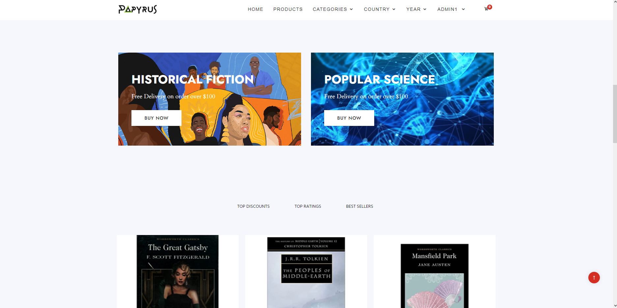
Demo Pictures
Home page

Slide 10
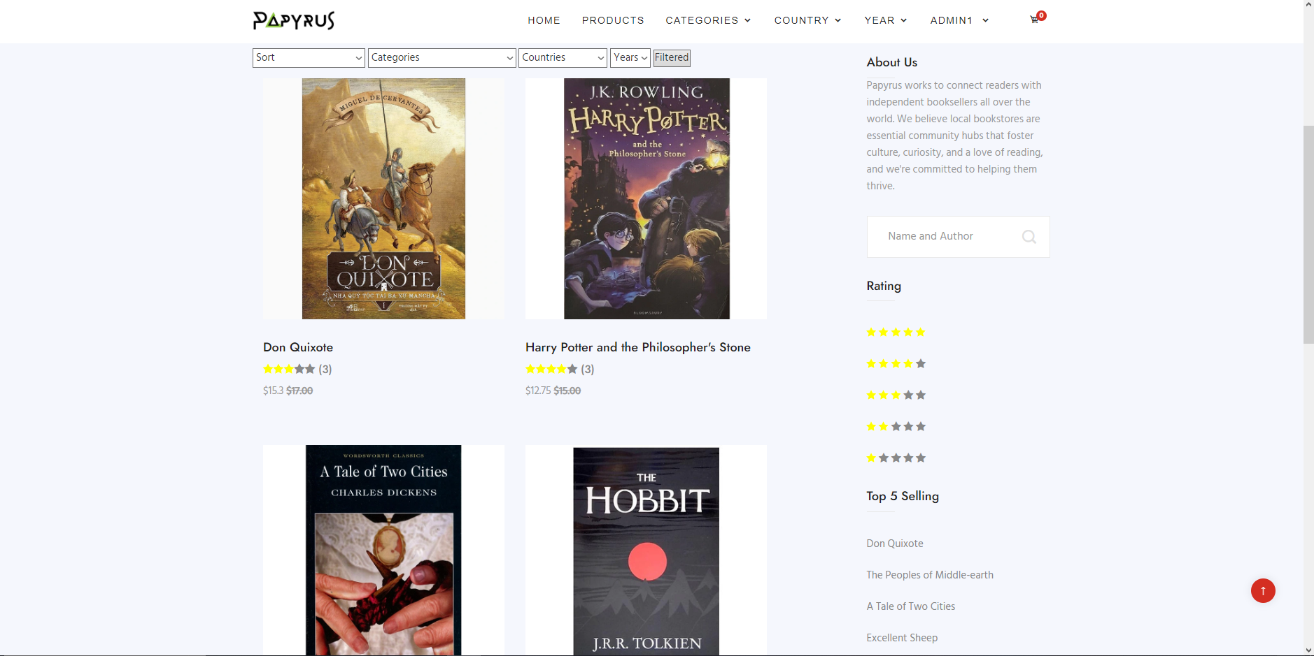
Demo Pictures
Product page

Slide 11
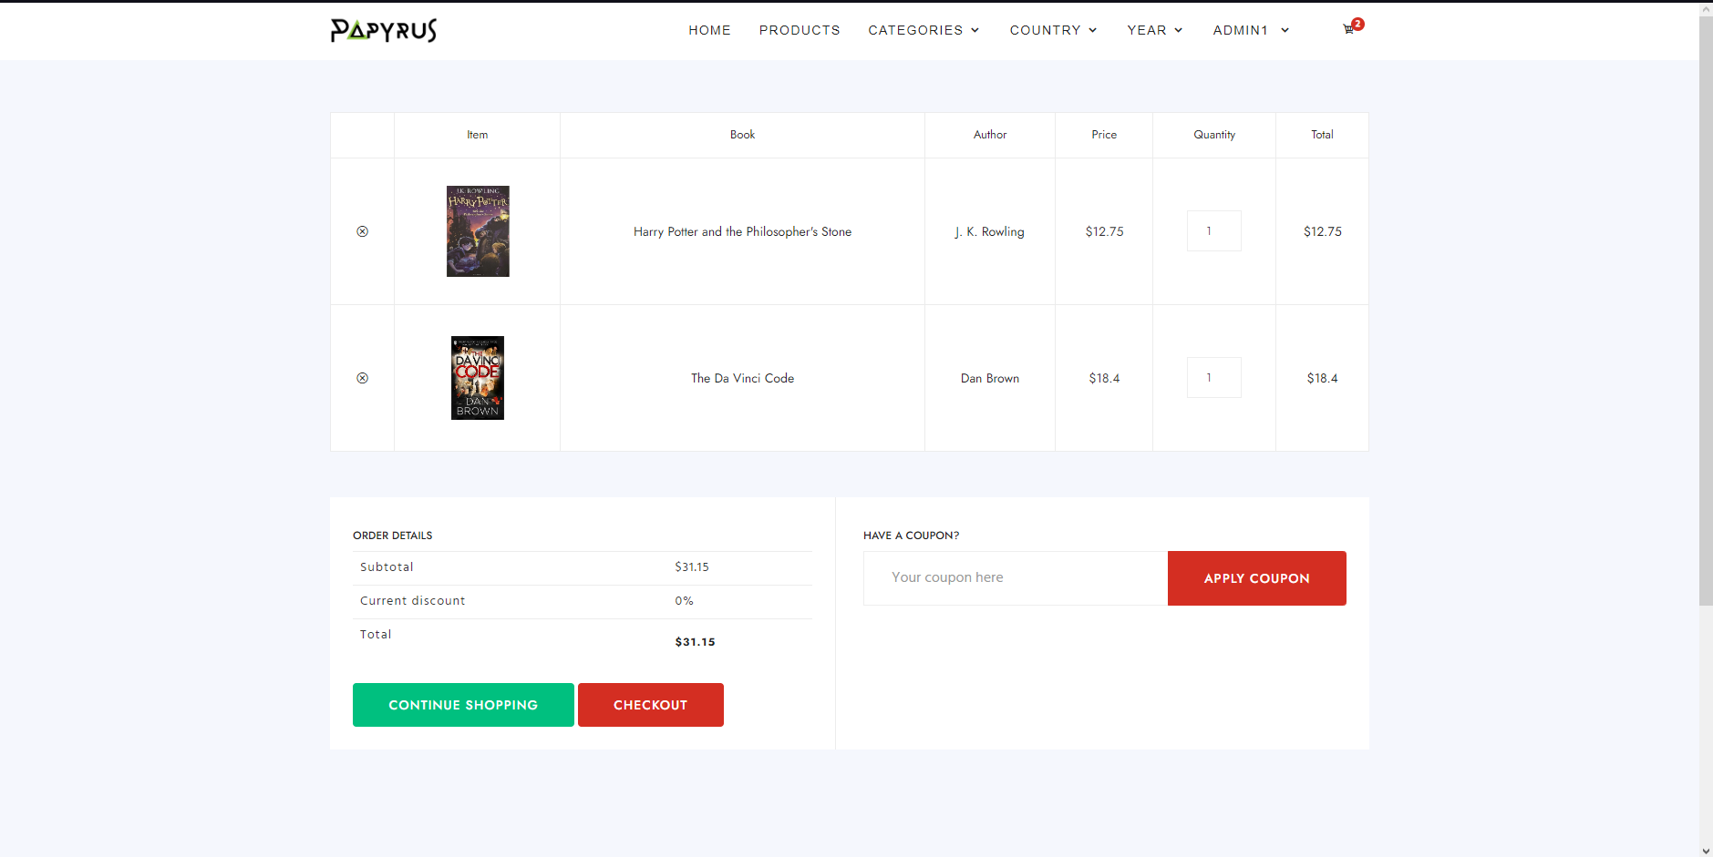
Demo Pictures
Cart page

Slide 12
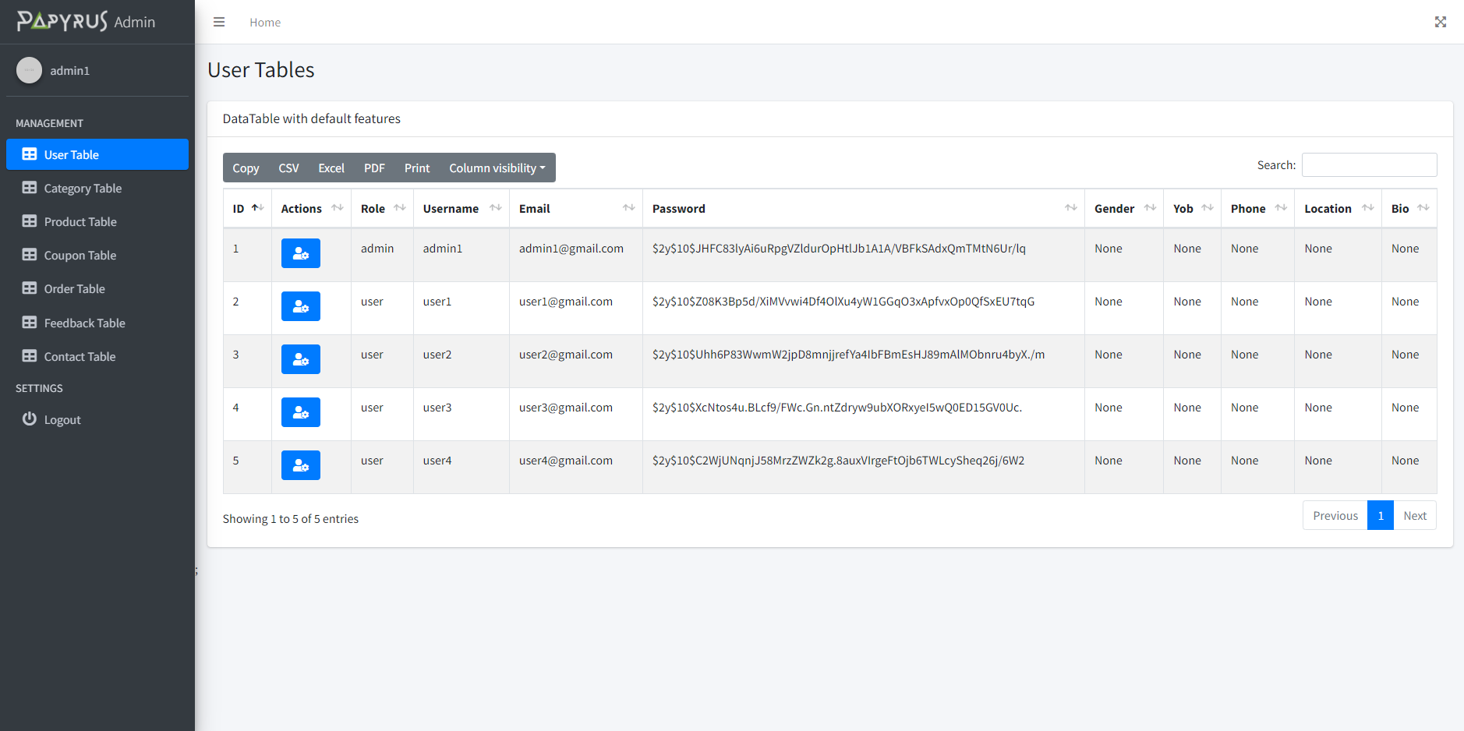
Demo Pictures
Admin page

Slide 13
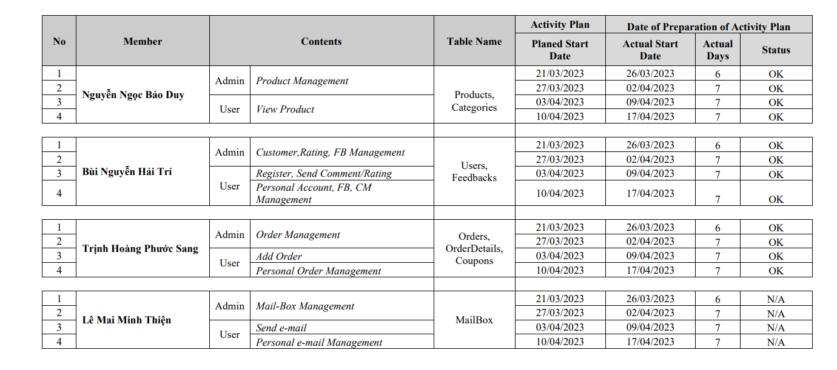
Task List

Slide 14
References
https://laravel.com/docs/10.x
https://stackoverflow.com
https://getbootstrap.com
https://fontawesome.com
https://laracasts.com

Slide 15

Thank You

